Slide 1


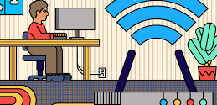

CNS PROJECT
TEAM MEMBERS:​
S.J SUMANTH(2010030377)​
K. SREEVARUN(200030451)​
E. PAVAN SAI(2010030538)​
E. SHIVA GOUD(2010030542)​

Slide 2
Outline:
Project-1:
Introduction
Abstract
Literature review
Methods
Conclusion
Results
Discussion

Slide 3
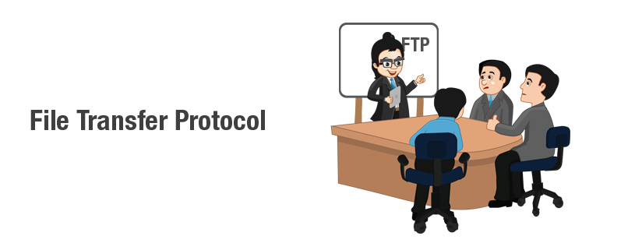

Slide 4
Abstract
File Transfer Protocol is used for transferring files to clients over networks using client-server architecture.
FTP provides two mechanisms for file transfer; one is anonymous method and another one is password authentication mechanism. All the communication between client and server is without encryption means data is transferred in clear text whether it is password or ftp commands.
There are some requirements which are considered important while file transfers and these are Authentication, Integrity and Confidentiality.

Slide 5


Abstract
For implementing security in file transfer protocol, we use FTPS rather than FTP as it is more secure. As FTPS uses some encryption mechanisms, it adds some extra process which effects the performance
In this presentation we discuss about FTP and FTP Server Connection.

Slide 6
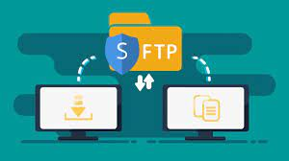
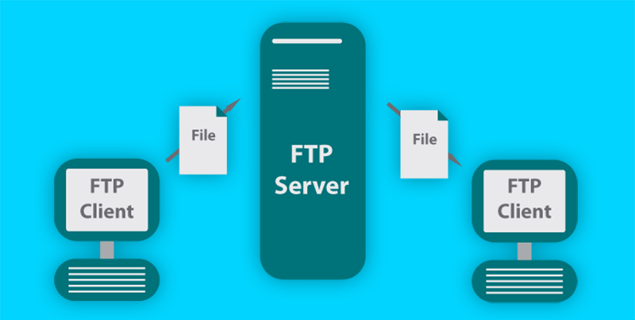
Introduction:
File Transfer Protocol (FTP) is a communications protocol used to send files from computer to computer, with one of them acting as the server, providing the two have an Internet connection.
A networking protocol between client and server, FTP allows users to download web pages, files, and programs that are available on other services. When the user wants to download the information to their own computer, they are using FTP.
An FTP server is a computer program that is built to handle data transfer between computers. The server waits for clients to connect to it and issue commands that tell the server to upload, download, or list directories. The FTP protocol is the commands the FTP server uses to accomplish this.

Slide 7

Literature Review
The far the FTP protocol has reached has its roots in the early 1970s when the Request For Comments (RFC) 14 standards were published on 16 April 1971 by Abhay Bhushan. This development proceeded with the transmission control protocol and internet protocol that were developed in early 1980.
During this tie, the internet was not able to relay information back since Arpanet was small. Hence, few development computers were available. Any development went on as new standards arose thus overtaking the former versions of the FTP.
For instance, the publication of RFC 172 happened in June 1971. Other standards referred to as RFC 265 came in to being in November 1971. However, a major transformation was evident in July 1972 following the publishing of the RC 354.

Slide 8
Literature Review cont.
ARPANET adopted TCP/IP on January 1, 1983, and from there researchers began to assemble the “network of networks” that became the modern Internet. This has seen the emergence of the modem FTP protocol used to transfer large files effectively as opposed to the earlier FTP protocol. It is also evident that security has also been improved through the application of password, username, encryptions, and many other security measures.
In 1985, a new version of the File Transfer Protocol, RFC 959, is published. This is the same specifications that are being used today.
In June of 1996 a revision was made to RFC 959 to add security extension to the File Transfer Protocol (RFC 2228).
In September of 1998 another revision was made to RFC 959 to add support for IPv6 and defined a new type of passive mode (RFC 2428).

Slide 9

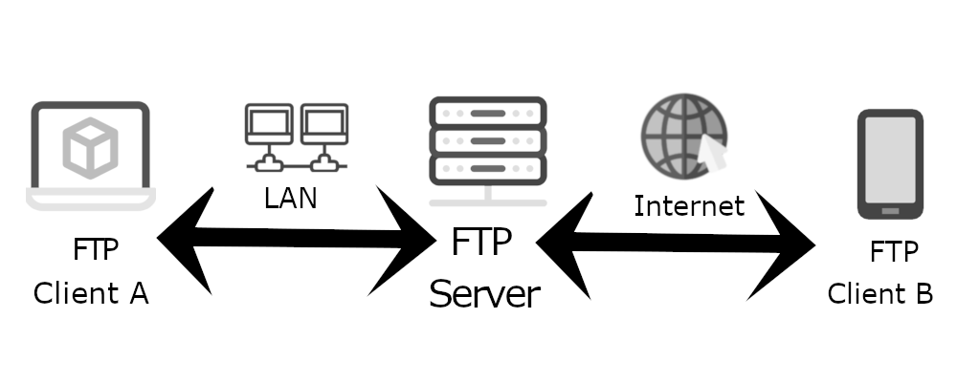
Methods
If you send files using FTP, files are either uploaded or downloaded to the FTP server. When you’re uploading files, the files are transferred from a personal computer to the server. When you’re downloaded files, the files are transferred from the server to your personal computer. TCP/IP (Transmission Control Protocol/Internet Protocol), or the language the internet uses to execute commands, is used to transfer files via FTP.
Uploading Files
Personal Computer --------> Server
Downloading Files
Server --------> Personal Computer

Slide 10
results
We got following results from our study:
FTP has many features that have enabled it transfer files besides ensuring security of the systems. One of the features of FTP is that they have ports that help in communication. For instance, port 21 helps the client computer to communicate/send files and data from one computer to the other.
FTP server is a feature of the file transfers. The server acts as the transmission medium. It stores information or data awaiting relay to the other host computer. Therefore, without these servers the FTP cannot run function smoothly. FTP also has features that allow download and transfer of multimedia files such as video files, images, game demos, software, patches, and music.

Slide 11
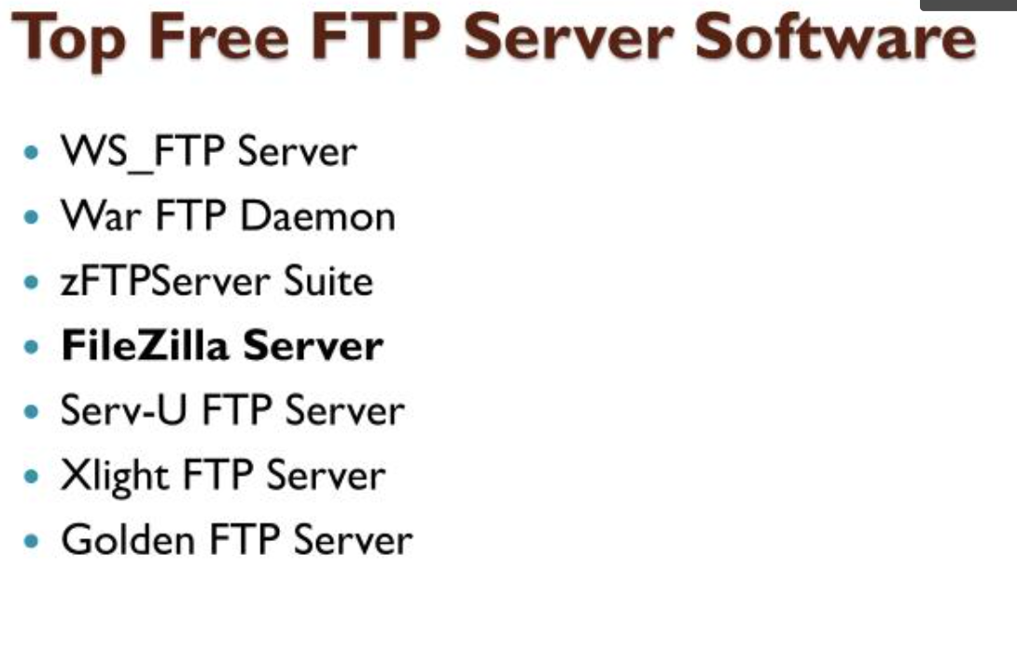

Slide 12

DISCUSSION
ADVANTAGES:
File transfer protocol has many advantages. One of the advantages that file transfer protocol has brought is that bigger files can be transferred from one computer to another within the shortest time possible.
FTP servers have security measures in place that help in securing the information transmitted over the internet. Before logging in, users are supposed to enter their user names and passwords. This ensures that only authorized users get access to certain information and data.
FTP enables one to send and receive information on the same server. This has made it easier for companies or users to exchange files and conversations with ease. For instance, an employer can communicate with the employees by sending messages and receiving their responses with ease and at low costs.
DISADVANTAGES:
FTP has a number of disadvantages. One of the disadvantages of FTP is that it is not designed as a secure protocol. It has many flaws in its security systems. The FTP is prone to virus attacks that may corrupt files that are sent through it. This is risky because the virus can be transmitted to another host computer thus affecting the files and programs of the system. Therefore, it poses a threat to security

Slide 13

Conclusion
File transfer protocol allows individuals and businesses to share electronic files with others without having to be in the same space. This can be done using an FTP client or through the cloud. Regardless of the option, both parties require a working internet connection.
Many people have used FTP before without even realizing it. If you have ever downloaded a file from a web page, you've used FTP. The first step is to log in, which may occur automatically or by manually inputting a username and password.
FTP was originally developed as a way to send and receive files between two physical computers. But with changes in technology, users can execute file transfers through the cloud. Using the cloud allows transfers to be done conveniently and safely

